Slide 1
Chapter Two
Asset Classes and Financial Instruments

Slide 2
Chapter Overview
Asset Classes
Fixed Income
Equity
Derivatives

Slide 3
Fixed Income
Asset Classes
Equity
Derivatives
Fixed Income
Money Markets
Capital Markets

Slide 4
The Money Market
Subsector of the fixed-income market
Short-term
Liquid
Low risk
Often have large denominations

Slide 5
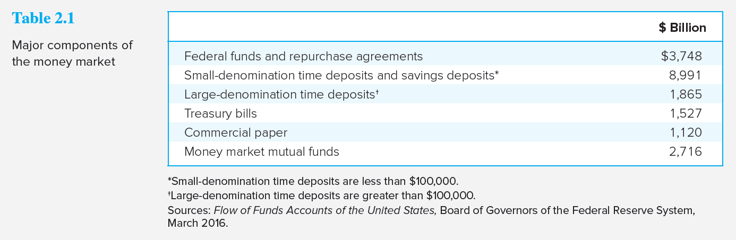
Major Components of the Money Market
Notes:
Money market mutual funds (MMMF) allow individuals to access the money market

Slide 6
Money Market Securities (1 of 2)
Treasury bills:
Bid and asked price
Bank discount method
Certificates of deposit:
Commercial paper:
Notes:
Treasury bills: Short-term debt of U.S. government
Bid and asked price
Bank discount method
Certificates of deposit: Time deposit with a bank
Commercial paper: Short-term, unsecured debt of a company

Slide 7
Money Market Securities (2 of 2)
Bankers’ Acceptances:
Eurodollars:
Repos and reverses:
Federal funds:
Notes:
Bankers’ Acceptances: An order to a bank by a bank’s customer to pay a sum of money on a future date
Eurodollars: Dollar-denominated time deposits in banks outside the U.S.
Repos and reverses: Short-term loan backed by government securities.
Federal funds: Very short-term loans between banks

Slide 8
Yields on Money Market Instruments
Money market securities are not free of default risk
The premium on bank CDs and the TED spread have often become greater during periods of financial crisis

Slide 9
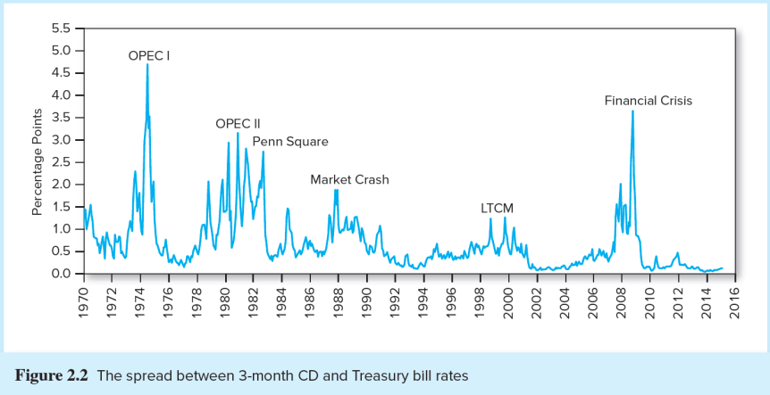
Spread between 3-month CD and Treasury Bills
Notes:
Note: During the credit crisis of 2008, the federal government offered insurance to money market mutual funds after some funds experienced losses

Slide 10
The Capital Market (1 of 2)
Capital Markets
Treasury Notes
Inflation-Protected Securities
Federal Agency Debt
International Bonds
Municipal Bonds
Corporate Bonds
Treasury Bonds
Notes:
Note: the terms Capital Markets and Bond Markets are used interchangeably

Slide 11
The Capital Market (2 of 2)
Subsector of the fixed-income market
Long-Term
Liquid
Low risk (but not as low as the Money Market)
Notes:
Think: Why are long-term bonds more risky than short term Money Market securities?

Slide 12
Capital Market: Treasury Notes and Bonds
Treasury Notes and Bonds
Maturities
Notes –
Bonds –
Par Value — $1,000
Interest paid semiannually
Quotes — Percentage of par
Notes:
Maturities:
Notes – Maturities up to 10 years
Bonds – Maturities from 10 to 30 years

Slide 13
Capital Market Securities
Inflation-Protected Treasury Bonds
TIPS:
Federal Agency Debt
Fannie Mae
Freddie Mac
Others
International Bonds
Eurobonds and Yankee bonds
Notes:
TIPS: (Treasury Inflation Protected Securities) - In the U.S., inflation-protected Treasury bonds are called TIPS

Slide 14
Capital Market: Municipal Bonds
Municipal Bonds
Issued by state and local governments
Interest is exempt from federal income tax and sometimes from state and local tax
Types
General obligation bonds:
Revenue bonds:
Notes:
Types:
General obligation bonds: backed by taxing power of issuer
Revenue bonds: backed by project’s revenues or by the municipal agency operating the project

Slide 15
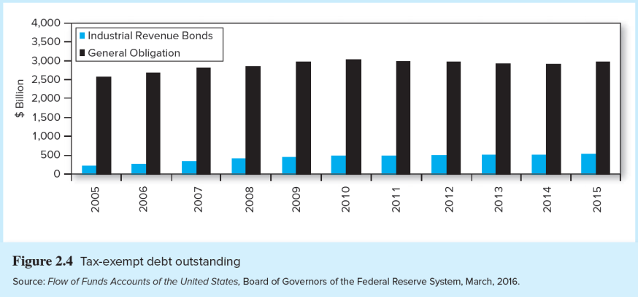
Tax-Exempt Debt Outstanding

Slide 16
Municipal Bond Yields Taxable vs. Tax-Exempt Bonds
Compare after-tax returns on each bond
Let t = investor’s marginal tax bracket
Let r = the before-tax return on the taxable bond
Let r_{m} = the municipal bond rate
If
then the taxable bond gives a higher return; otherwise, the municipal bond is preferred

Slide 17
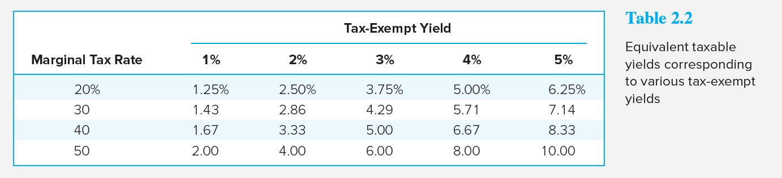
Tax-Exempt Yield Table
Notes:
Note: The equivalent taxable yield is simply the tax-free rate, r_{m}, divided by (1 - t).

Slide 18
Capital Market: Corporate Bonds
Corporate Bonds
Issued by private firms
Semi-annual interest payments
Larger default risk than government securities
Options in corporate bonds
Callable
Convertible

Slide 19
Capital Markets: Mortgage Backed Securities
Mortgage-Backed Securities
Proportional ownership of a mortgage pool or a specified obligation secured by a pool
Produced by securitizing mortgages
Most were issued by Fannie Mae and Freddie Mac
Notes:
Note: Mortgage-backed securities are called pass-throughs because the cash flows produced by homeowners paying off their mortgages are passed through to investors.

Slide 20
Bond Market Securities
Mortgage-Backed Securities
Traditionally conforming mortgages
Later, “private-label” issuers securitized large amounts of subprime mortgages
Fannie and Freddie were allowed and even encouraged to buy subprime mortgage securities
Notes:
Note: Conforming mortgages met standards of credit worthiness
Subprime mortgages were made to financially weak borrowers

Slide 21
Mortgage-Backed Securities Outstanding

Slide 22
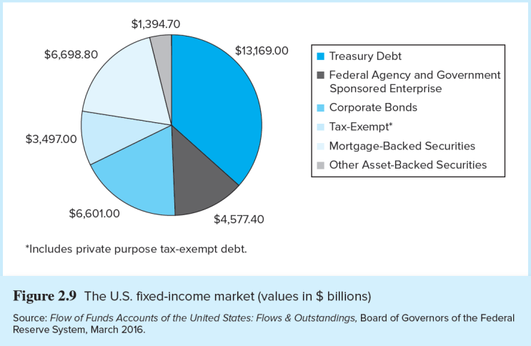
U.S. Fixed-Income Market

Slide 23
Equity
Asset Classes
Equity
Derivatives
Fixed Income
Common Stock
Preferred Stock
ADRs

Slide 24
Equity Securities: Common Stock
Common stock
Ownership
Residual claim
Limited liability

Slide 25
Equity Securities: Preferred Stock
Preferred stock:
Perpetuity
Fixed dividends
Priority over common
Tax treatment

Slide 26
Equity Securities: ADR
American Depository Receipts (ADR)
Certificates traded in U.S. markets that represent ownership in shares of a foreign company

Slide 27
Stock Basics
Dividend Yield:
Capital Gains:
P/E Ratio:
Notes:
Notes:
Dividend Yield: Yearly Dividends / Purchase Price
Capital Gains (losses): Share Price Increases (Decreases)
P/E Ratio: Price-Earnings Ratio = Price Per Share Divided by Earnings Per Share

Slide 28
Stock Market Indices
Dow Jones Industrial Average
Includes 30 large blue-chip corporations
Computed since 1896
Price-Weighted Index
S&P 500
Broad based index of 500 firms
Market-Value-Weighted Index

Slide 29
Stock Market Indexes
Investors can base their portfolios on an index
Buy an index mutual fund
Buy exchange-traded funds (ETFs)

Slide 30
Other Indices
U.S. Indexes
Foreign Indexes
NYSE Composite
NASDAQ Composite
Wilshire 5000
Nikkei (Japan)
FTSE (U.K.; pronounced “footsie”)
DAX (Germany),
Hang Seng (Hong Kong)
TSX (Canada)

Slide 31
Derivatives
Asset Classes
Equity
Derivatives
Fixed Income
Options
Futures
A derivative is a security that gets its value from the value of another asset, such as commodity prices, bond and stock prices, or market index values
Notes:
31

Slide 32
Derivatives Markets: Options
Call Option:
Right to buy underlying asset at the strike price
Value of calls decreases as strike price increases
Put Option:
Right to sell underlying asset at the strike price
Value of puts increase with strike price
Both calls and puts increases with time until expiration
Notes:
Call Options: Right to buy underlying asset at the strike or exercise price
Value of calls decreases as strike price increases
Put Options : Right to sell underlying asset at the strike or exercise price
Value of puts increase with strike price
Note: Strike Price is interchangeable with Exercise Price

Slide 33
Derivatives Markets: Futures
Futures Contracts:
Long position:
Short position:
Notes:
Futures Contract: An agreement made today regarding the delivery of an asset (or in some cases, its cash value) at a specified delivery or maturity date for an agreed-upon price, called the futures price, to be paid at contract maturity
Long position: Take delivery at maturity
Short position: Make delivery at maturity

Slide 34
Comparison
Option
Futures Contract
Right, but not obligation, to buy or sell
Option is exercised only when it is profitable
Options must be purchased
The premium is the price of the option itself
Obliged to make or take delivery
Long (short) position must buy (sell) at the futures price
Futures contracts are entered into without cost

